Slide 1
CT 208: Principles of Programming Languages and
CT 209: PPL Lab
Abhijit A.M.
abhijit.comp@coep.ac.in

Slide 2
What do you expect from this course ?

Slide 3
What PPL is all about
“Principles” of languages
  Know how languages get designed
  Issues in developing new language
Different attitudes towards programming: Object oriented, functional, procedural, etc.
  Major emphasis on OO programming
Improving programming
Getting introduced to many languages
  Learn a language in 2 days !

Slide 4
What PPL is NOT!
NOT about any particular language: Java, Python, ...
  Although we'll be using Python for programming, its a tool not the aim
  Focus on Concepts, not language libraries
Not a Linux course

Slide 5
Why Study PPL ?
Languages – The next most
important thing after data structures
Object Oriented Programming !
Job!

Slide 6
Languages for lab work
Python mainly
HTML
Some code to be written using Java, Perl, LISP, etc.

Slide 7
Further in the lab
Many small assignments
  C, Python mainly
  Many other languages, 1 assignment each
  No Credit, To be done individually
One big assignment
  Using Python – on Object oriented programming
  No Credit
Lab tests and Endsem will be based on assignments

Slide 8
Attendance
Satisfactory attendance is required from everyone
No need to ask for permission while entering and leaving the class

Slide 9
Study Material
Programming Languages, Design and Implementation, 4th Edition
  By T W Pratt and M V Zelkowitz
  Published by Prentice Hall of India
  Price 160 to 200/- Rs
Learning Python 4th Edition, by Mark Lutz, O'Reilly publishers
For OO Programming Concepts – I'll send notes, and presentation

Slide 10
Moodle
Moodle has changed!
Moodle is now on internet
  http://moodle.coep.org.in
Internally can be accessed also at
  http://172.16.1.75

Slide 11
Python
Why study Python ?
Because Abhijit wants it!
One of the most promising languages of the time
Has procedural, Object oriented, Functional programming features together
Very easy to learn, and write code in !
Interpreted language

Slide 12
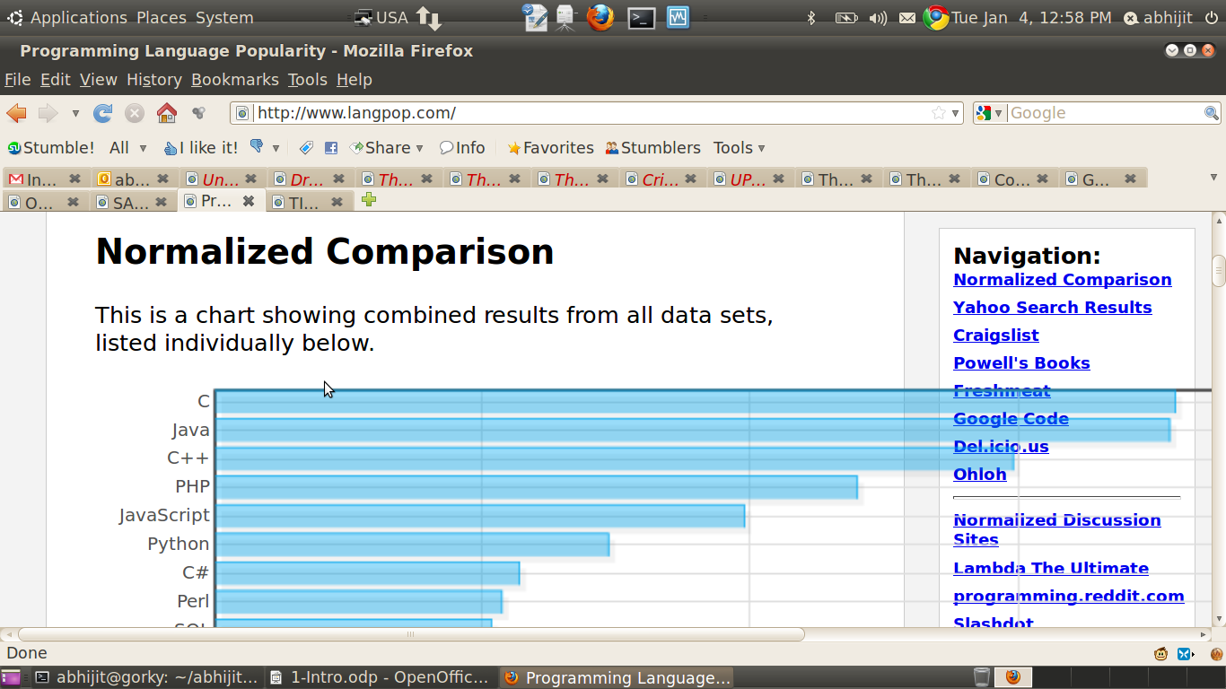

Slide 13
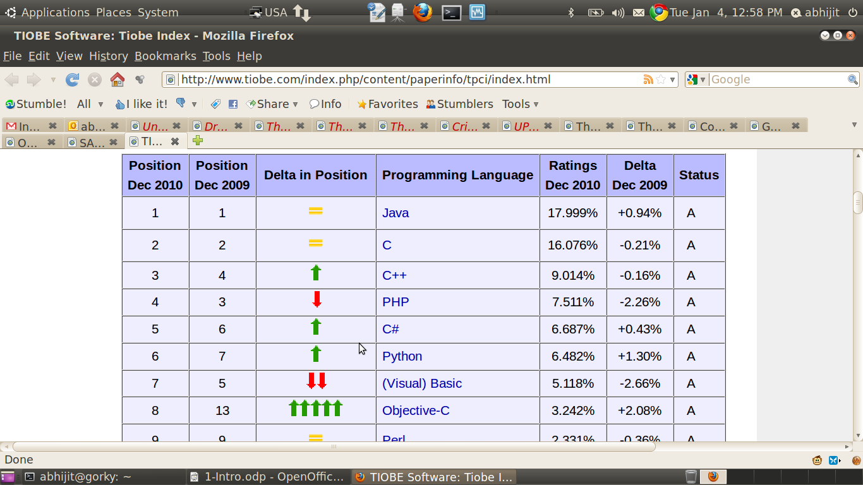

Slide 14
Python Vs Java
There is lot of talk and enthusiasm about Java
  The talk is not hype
  But Java is the old thing now..
You can learn Java in 2 days, if you learn PPL !

Slide 15
Java, Java
Companies ask for Java !
  Tell them to ask you Python!
  Any company which prominently tests your langauge skills is not a good company to work for !
  My job is not to create ready-made employees for the companies. I believe the college should create engineers with sound fundamentals

Slide 16
Python Used In Making
Bittorrent (you know it ;) )
Blender(3D) (A Movie-making tool)
PiTiVi( A Video editor)
Ubuntu Software Center
OpenERP
Video games like Freedom Force, Vega Strike, Battlefield2, star trek, etc.
Google App Engine !
PyCuda, PyGTK, SciPy

Slide 17
Some Organizations using python
Google
  Gmail, groups, maps, app engine, ...
NASA
Yahoo
  Groups, maps
Youtube !
Walt Disney Animations
Redhat
SGI
Nokia
Realnetworks
USA- CIA

Slide 18
So, Why Study Python ?
Because It's FOSS !

Slide 19
Engineering Attitude
What is it ?
Scientific attitude
How to inculcate it ?
Ask Questions! --- Why, How, What ?
Learn to learn
Experiment – be brave !
Care less, enjoy more !

Slide 20
Some questions
What is the size of integer in C?
  Why ?
Are these equivalent in C ?
(P!=NULL && p->val != val) instead of (p->val != val && p!= NULL)
  Why ?
In which langauge will you write the code for Air Traffic Controller ?
  Why ?

